Slide 1
BIKE and HQC
Presented by Ray Perlner

Slide 2
BIKE and HQC teams
BIKE1, HQC1, HQC2 – Primary (1) and secondary (2) contacts for BIKE, HQC
New Submitter (Valentin Vasseur) for BIKE – Probably added for BIKE-CCA decoder
New Developer (Jurjen BOS) for HQC
Both | BIKE Only | HQC Only
Nicolas Aragon Slim Bettaieb Loïc Bidoux Olivier Blazy Jean Christophe Deneuville (HQC 2) Philippe Gaborit (HQC 1) Edoardo Persichetti Gilles Zémor | Paolo Barreto Rafael Misoczki (BIKE 1) Nicolas Sendrier Jean Pierre Tillich Valentin Vasseur (New for Round 2) | Carlos Aguilar Melchor Jurjen Bos (Developer, Round 2)

Slide 3
Intro Summary
BIKE and HQC have a lot in common:
  NTRU-like and Ring-LWE-like constructions based on shortness in the Hamming Metric
  Information set decoding is the primary means of Cryptanalysis
  All matrices use quasicyclic structure
Differences
  HQC decodes using a public error correcting code (BCH ⊗ Repetition)
    Only includes a single Ring-LWE-like construction
  BIKE uses a bit-flipping decoder for a hidden QC-MDPC code
    Packages 2 NTRU-like variants (BIKE 1,2) and a Ring-LWE-like variant (BIKE3)
  In Round 1, BIKE had a higher DFR than HQC and targeted IND-CPA security
    Round 2 BIKE retains IND-CPA version, but adds IND-CCA version using a more complicated decoder

Slide 4
BIKE and HQC in context
 | Private Decoder |  | Public Decoder
 | NTRU-like | Ring-LWE-like (Ouroboros) | Ring-LWE-like
Hamming Metric | BIKE-1,2 LEDAcrypt | BIKE-3 | HQC
Rank Metric | ROLLO-1,2 | ROLLO-3 | RQC
Euclidean Metric | NTRU NTRU Prime |  | LAC NewHope

Slide 5
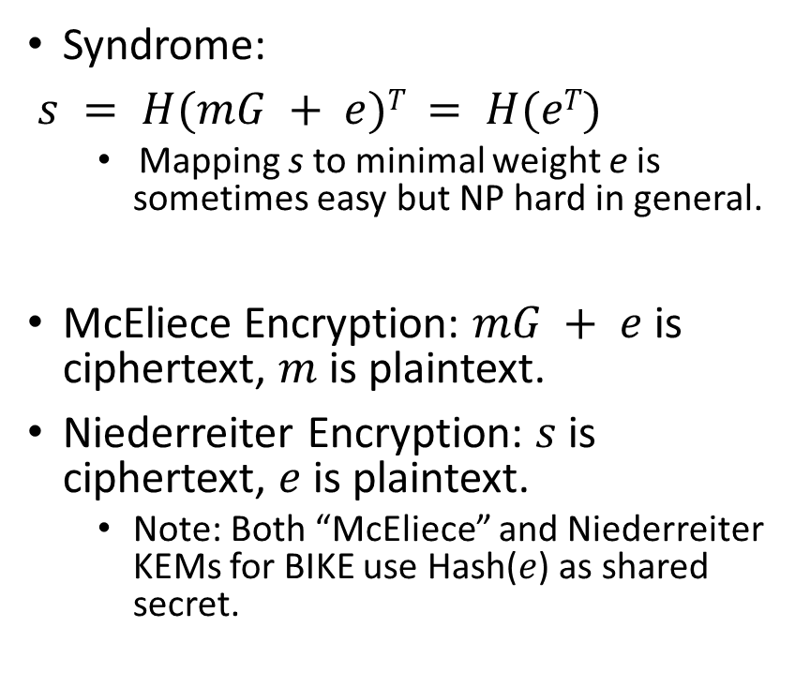
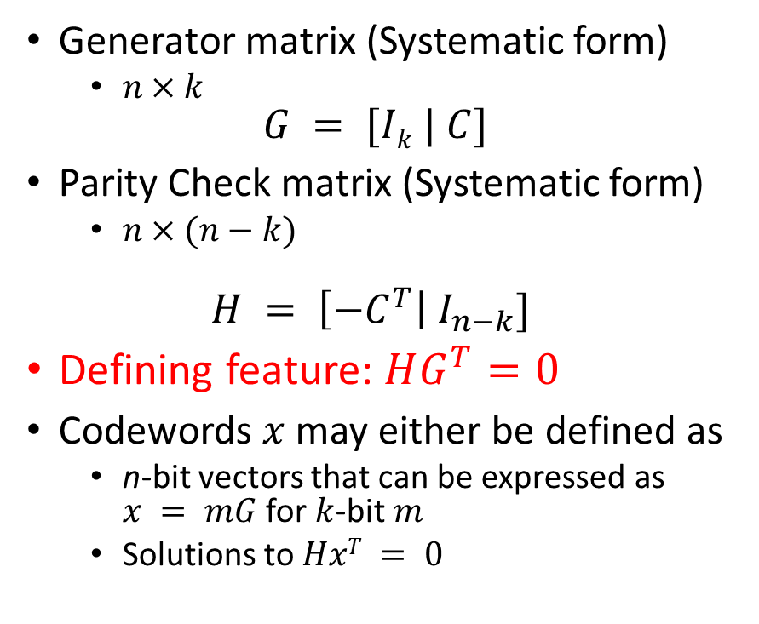
Some Coding Theory
Generator matrix (Systematic form)
  $n×k$
$$G = [Ik | C]$$
Parity Check matrix (Systematic form)
  $n×(n−k)$
$$H = \left[{−C}^{T}\right| I_{n−k}]$$
Defining feature: $HG^{T}=0$
Codewords $x$ may either be defined as
  n-bit vectors that can be expressed as $x = mG$ for $k$-bit $m$
  Solutions to $HxT = 0$
Syndrome:
$s = H(mG + e)T = H(eT)$
  Mapping s to minimal weight e is sometimes easy but NP hard in general.
McEliece Encryption: $mG + e$is ciphertext, $m$ is plaintext.
Niederreiter Encryption: $s$ is ciphertext, $e$ is plaintext.
  Note: Both “McEliece” and Niederreiter KEMs for BIKE use Hash($e$) as shared secret.

Slide 6
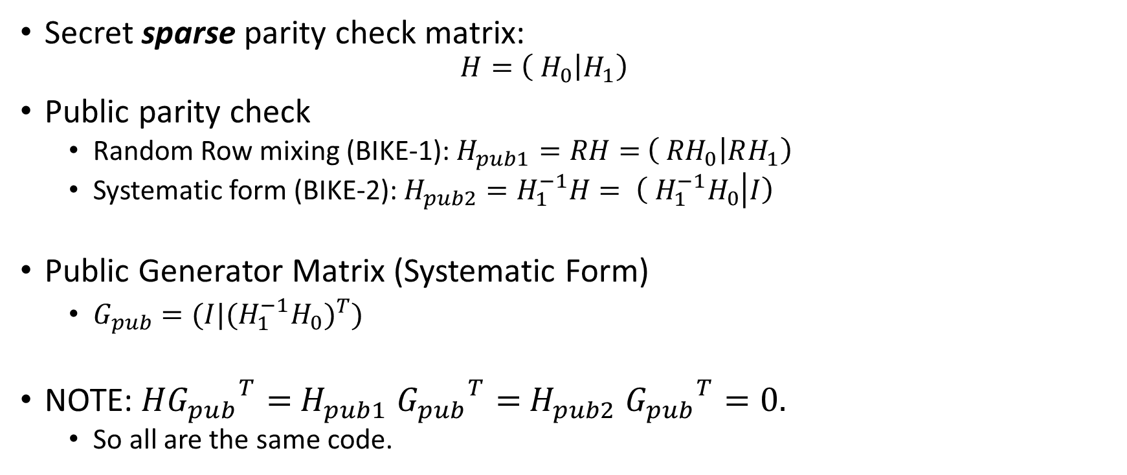
MDPC (Moderate Density Parity Check) Codes
(special case where n = 2k)
Secret sparse parity check matrix:
  $$H=\left( H_{0} | H_{1}\right)$$
Public parity check
  Random Row mixing (BIKE-1): $H_{pub1}=RH=$ $\left( {RH}_{0} | RH_{1}\right)$
  Systematic form (BIKE-2): $H_{pub2}=H_{1}^{−1}H= \left( {H_{1}^{−1}H}_{0} | I\right)$
Public Generator Matrix (Systematic Form)
  $G_{pub}=(I|{{{(H}_{1}^{−1}H}_{0})}^{T})$
NOTE: $H{G_{pub}}^{T}=$ $H_{pub1}$ ${G_{pub}}^{T}=$ $H_{pub2}$ ${G_{pub}}^{T}=0.$
  So all are the same code.

Slide 7

Decoding MDPC codes
(The Bit-Flip Algorithm)
Want to find low weight e such that $He^{T}=s$

Slide 8

Decoding MDPC codes with noisy syndrome
(used in BIKE-3)
Want to find low weight e, e’ such that $He^{T}+ {e′}^{T}=s$
Or equivalently: $\left(\begin{matrix}I & H\end{matrix}\right)\left(\begin{matrix}{e′}^{T} \\ e^{T}\end{matrix}\right)=s$

Slide 9
The last two slides are lies! (sort of)
New decoding algorithms given for round 2
  CPA versions: Actual algorithm is given by “one round bit flipping decoder”
  CCA versions: Actual algorithm is given by “backflip decoder”
    Note: Submission did not give max iteration counts for CCA algorithm. (I missed this in my completeness review)
  Algorithms are slightly too long to fit on a slide and not conceptually different

Slide 10
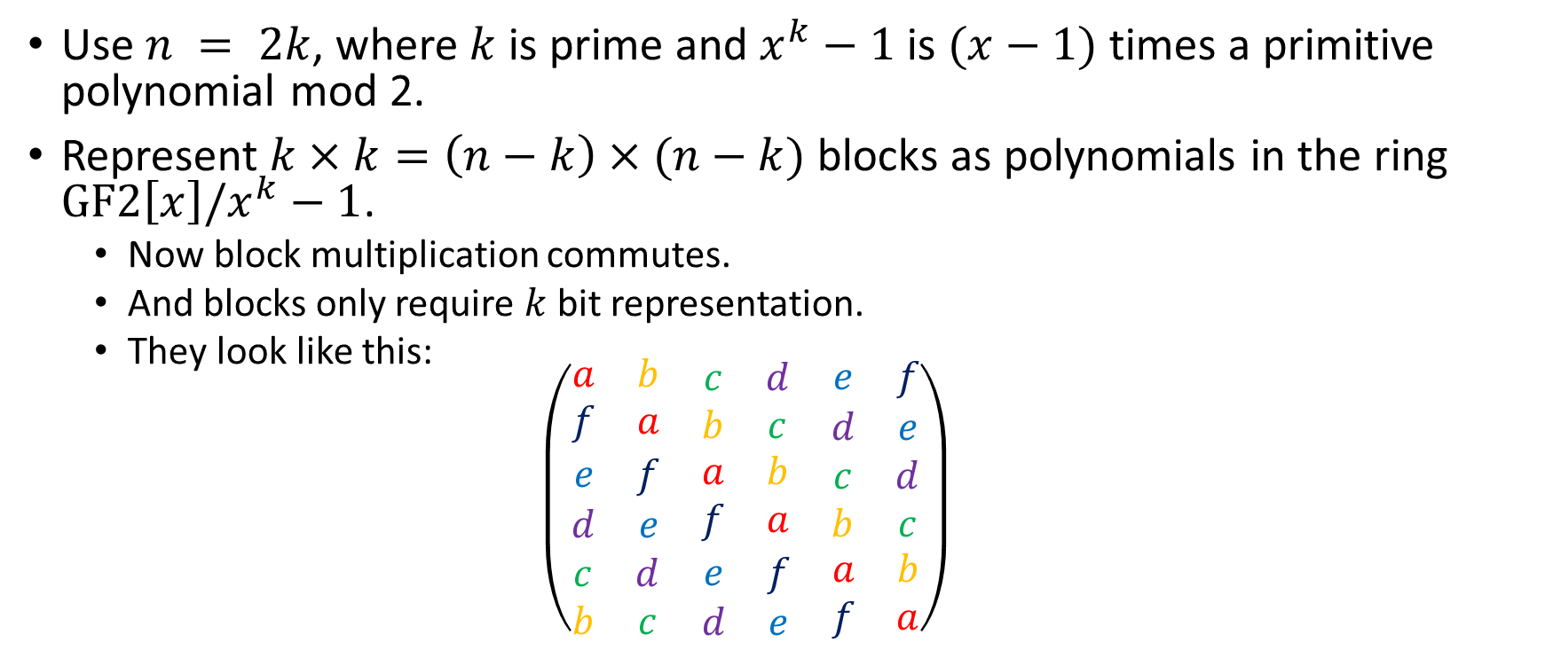
Quasi-Cyclic structure
Use $n = 2k$, where $k$ is prime and $x^{k}−1$ is $(x−1)$times a primitive polynomial mod 2.
Represent $k×k=\left(n−k\right)×(n−k)$ blocks as polynomials in the ring $GF2\left[x\right]/x^{k}−1$.
  Now block multiplication commutes.
  And blocks only require $k$ bit representation.
  They look like this:
  $$\left(\begin{matrix}\begin{matrix}a & b \\ f & a\end{matrix} & \begin{matrix}c & d \\ b & c\end{matrix} & \begin{matrix}e & f \\ d & e\end{matrix} \\ \begin{matrix}e & f \\ d & e\end{matrix} & \begin{matrix}a & b \\ f & a\end{matrix} & \begin{matrix}c & d \\ b & c\end{matrix} \\ \begin{matrix}c & d \\ b & c\end{matrix} & \begin{matrix}e & f \\ d & e\end{matrix} & \begin{matrix}a & b \\ f & a\end{matrix}\end{matrix}\right)$$

Slide 11
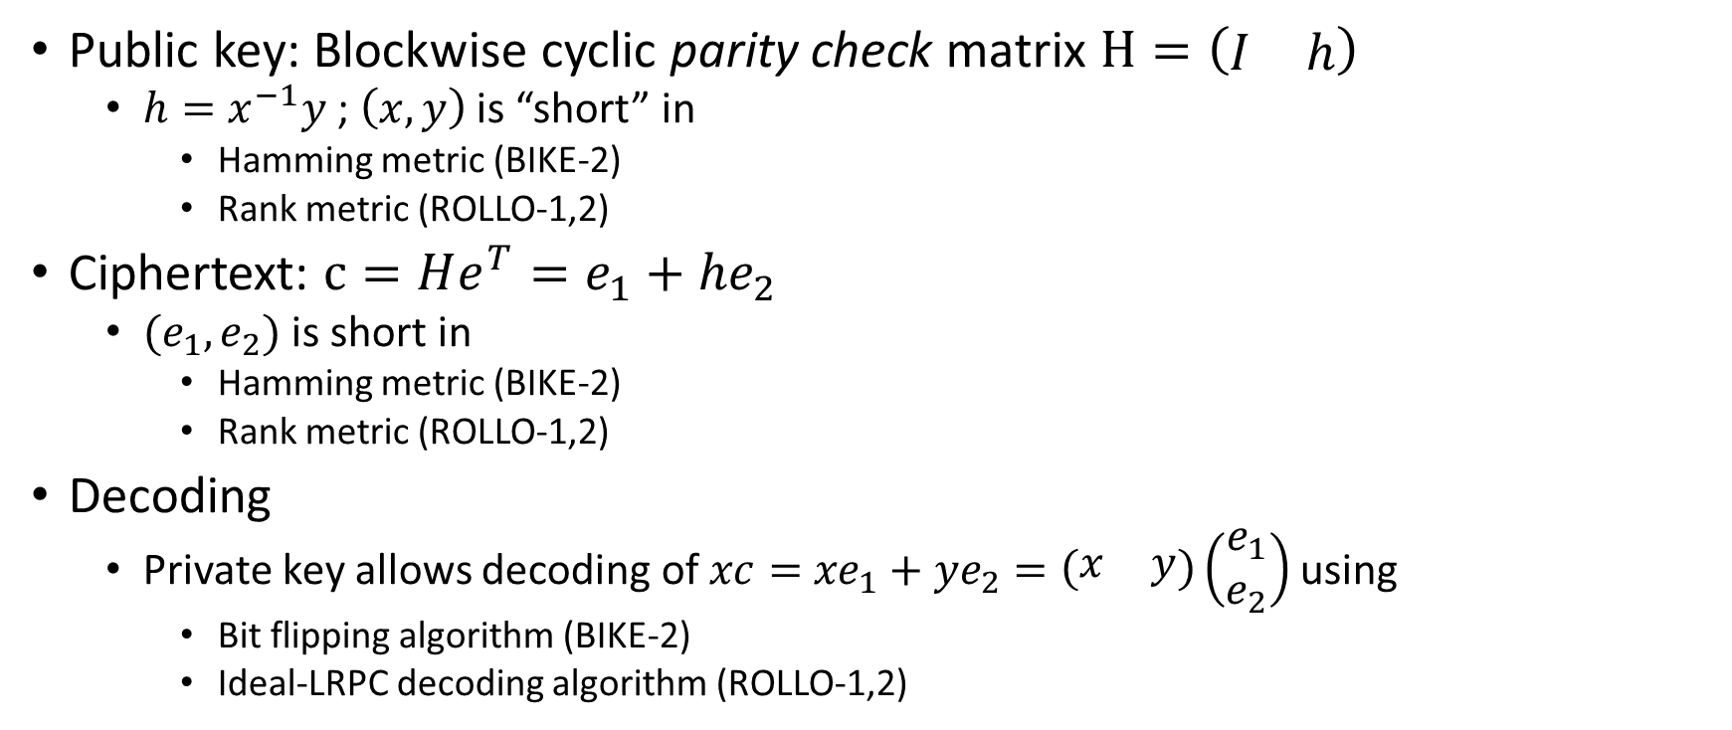
BIKE-2 construction
(Niederreiter)
Public key: Blockwise cyclic parity check matrix $H=\left(\begin{matrix}I & h\end{matrix}\right)$
  $h=x^{−1}y$ ; $\left(x,y\right)$ is “short” in
    Hamming metric (BIKE-2)
    Rank metric (ROLLO-1,2)
Ciphertext: $c=He^{T}=e_{1}+{he}_{2}$
  $(e_{1},e_{2})$ is short in
    Hamming metric (BIKE-2)
    Rank metric (ROLLO-1,2)
Decoding
  Private key allows decoding of $xc=$ ${xe}_{1}+{ye}_{2}=\left(\begin{matrix}x & y\end{matrix}\right)\left(\begin{matrix}e_{1} \\ e_{2}\end{matrix}\right)$ using
    Bit flipping algorithm (BIKE-2)
    Ideal-LRPC decoding algorithm (ROLLO-1,2)

Slide 12
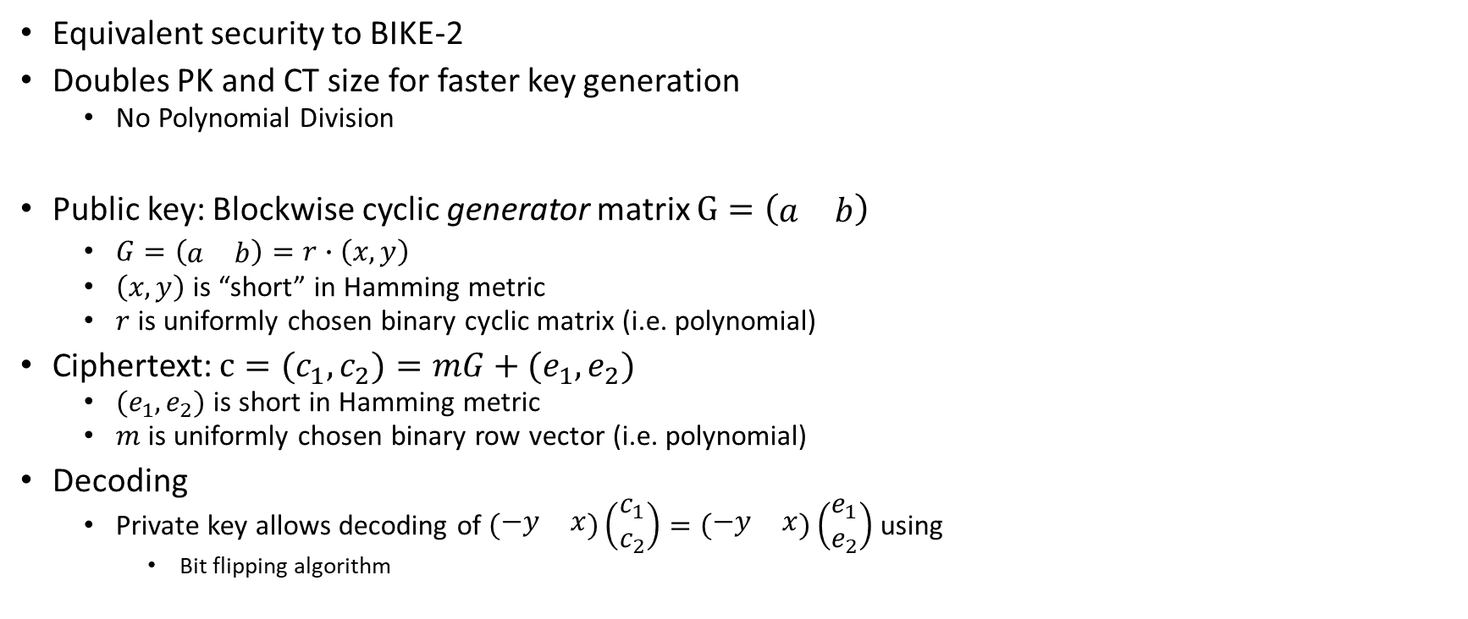
BIKE-1 construction
(McEliece)
Equivalent security to BIKE-2
Doubles PK and CT size for faster key generation
  No Polynomial Division
Public key: Blockwise cyclic generator matrix $G=\left(\begin{matrix}a & b\end{matrix}\right)$
  $G=\left(\begin{matrix}a & b\end{matrix}\right)=r∙\left(x,y\right)$
  $\left(x,y\right)$is “short” in Hamming metric
  $r$ is uniformly chosen binary cyclic matrix (i.e. polynomial)
Ciphertext: $c=(c_{1},c_{2})=mG+(e_{1},e_{2})$
  $(e_{1},e_{2})$ is short in Hamming metric
  $m$ is uniformly chosen binary row vector (i.e. polynomial)
Decoding
  Private key allows decoding of $\left(\begin{matrix}−y & x\end{matrix}\right)\left(\begin{matrix}c_{1} \\ c_{2}\end{matrix}\right)=\left(\begin{matrix}−y & x\end{matrix}\right)\left(\begin{matrix}e_{1} \\ e_{2}\end{matrix}\right)$ using
    Bit flipping algorithm

Slide 13
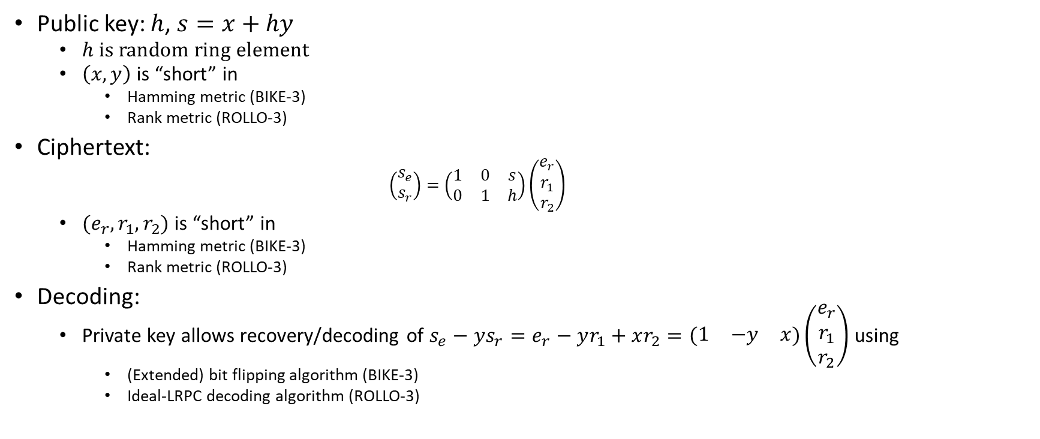
BIKE-3 construction
(Ouroboros)
Public key: $h$, $s=x+hy$
  $h$ is random ring element
  $\left(x,y\right)$ is “short” in
    Hamming metric (BIKE-3)
    Rank metric (ROLLO-3)
Ciphertext:
    $$\left(\begin{matrix}s_{e} \\ s_{r}\end{matrix}\right)=\left(\begin{matrix}1 & 0 & s \\ 0 & 1 & h\end{matrix}\right)\left(\begin{matrix}e_{r} \\ r_{1} \\ r_{2}\end{matrix}\right)$$
  $(e_{r},r_{1},r_{2})$ is “short” in
    Hamming metric (BIKE-3)
    Rank metric (ROLLO-3)
Decoding:
  Private key allows recovery/decoding of $s_{e}−ys_{r}=e_{r}−yr_{1}+xr_{2}=\left(\begin{matrix}1 & −y & x\end{matrix}\right)\left(\begin{matrix}e_{r} \\ r_{1} \\ r_{2}\end{matrix}\right)$ using
    (Extended) bit flipping algorithm (BIKE-3)
    Ideal-LRPC decoding algorithm (ROLLO-3)

Slide 14
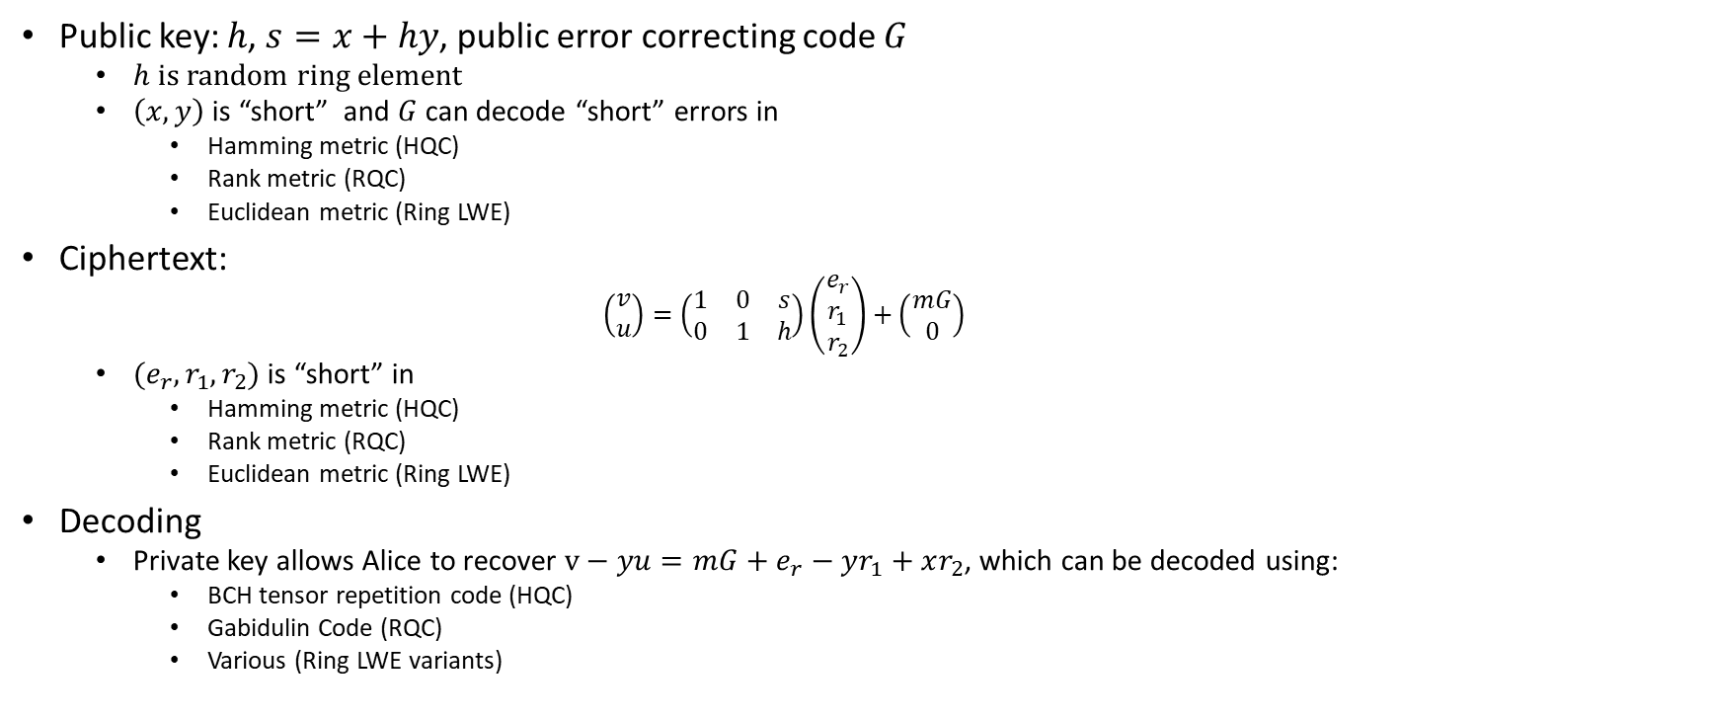
HQC Construction
Public key: $h$, $s=x+hy$, public error correcting code $G$
  $h$ is random ring element
  $\left(x,y\right)$ is “short” and $G$ can decode “short” errors in
    Hamming metric (HQC)
    Rank metric (RQC)
    Euclidean metric (Ring LWE)
Ciphertext:
    $$\left(\begin{matrix}v \\ u\end{matrix}\right)=\left(\begin{matrix}1 & 0 & s \\ 0 & 1 & h\end{matrix}\right)\left(\begin{matrix}e_{r} \\ r_{1} \\ r_{2}\end{matrix}\right)+\left(\begin{matrix}mG \\ 0\end{matrix}\right)$$
  $(e_{r},r_{1},r_{2})$ is “short” in
    Hamming metric (HQC)
    Rank metric (RQC)
    Euclidean metric (Ring LWE)
Decoding
  Private key allows Alice to recover $v−yu={mG+e}_{r}−yr_{1}+xr_{2}$, which can be decoded using:
    BCH tensor repetition code (HQC)
    Gabidulin Code (RQC)
    Various (Ring LWE variants)

Slide 15
BIKE CCA conversion
(Uses implicit rejection)
CPA:
CCA:

Slide 16
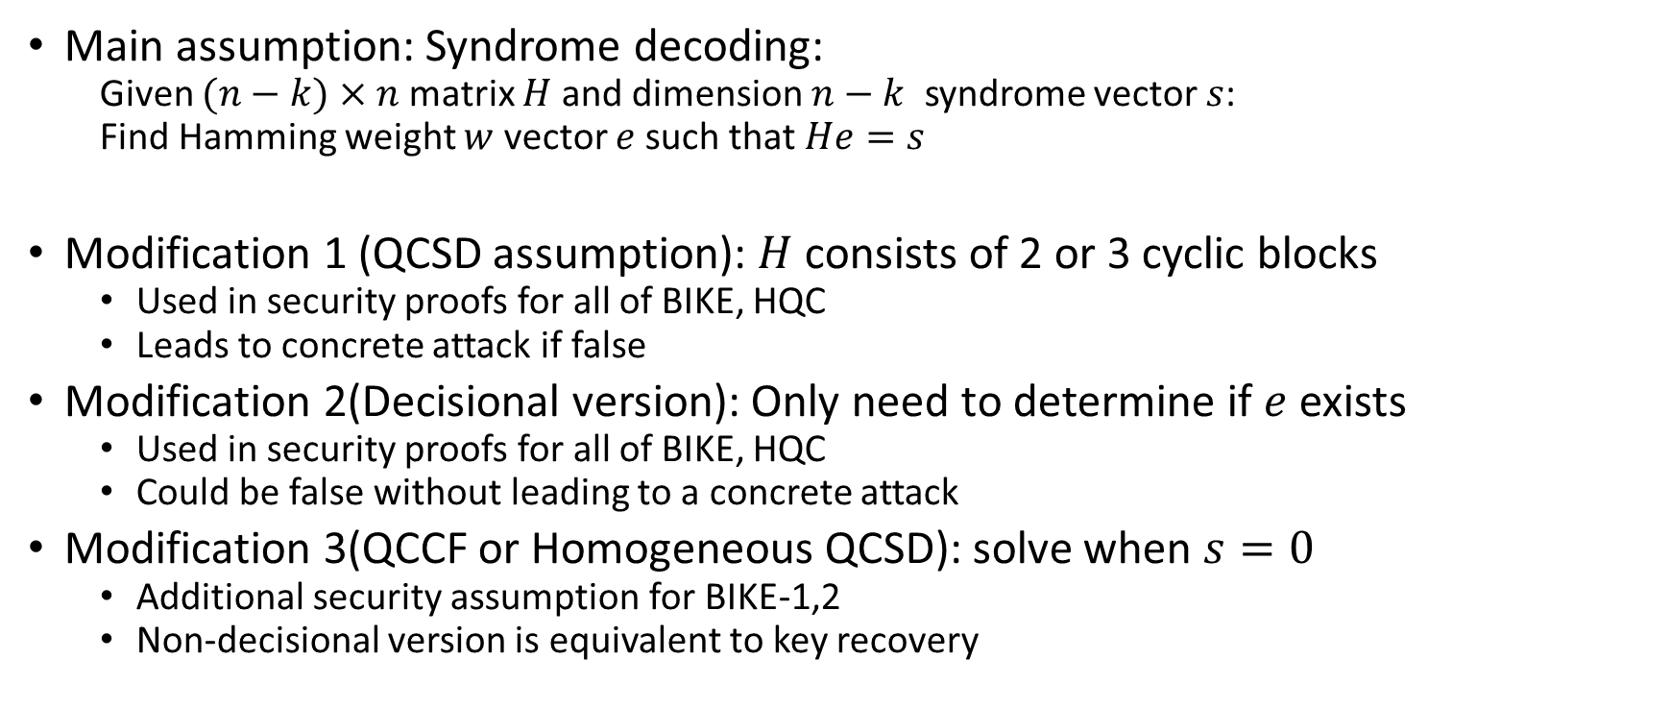
Security assumptions
Main assumption: Syndrome decoding:
  Given $(n−k)×n$ matrix $H$ and dimension $n−k$ syndrome vector $s$:
  Find Hamming weight $w$ vector $e$ such that $He=s$
Modification 1 (QCSD assumption): $H$ consists of 2 or 3 cyclic blocks
  Used in security proofs for all of BIKE, HQC
  Leads to concrete attack if false
Modification 2(Decisional version): Only need to determine if $e$ exists
  Used in security proofs for all of BIKE, HQC
  Could be false without leading to a concrete attack
Modification 3(QCCF or Homogeneous QCSD): solve when $s=0$
  Additional security assumption for BIKE-1,2
  Non-decisional version is equivalent to key recovery

Slide 17
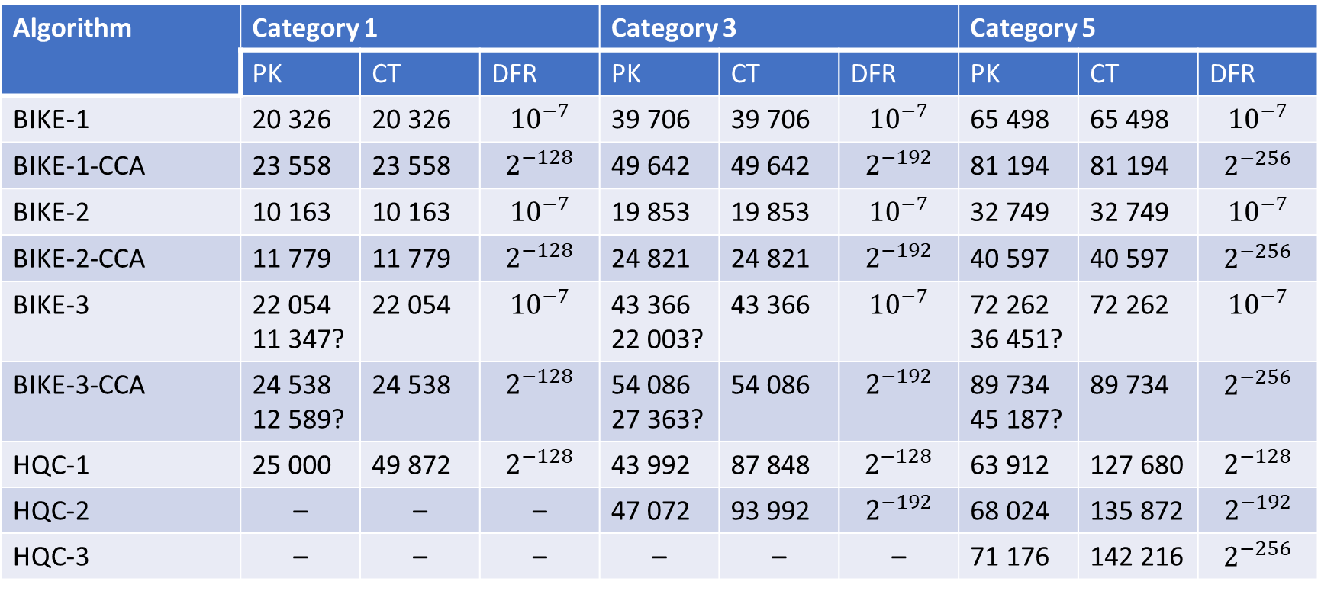
Key sizes (bits) and DFR
Algorithm | Category 1 |  |  | Category 3 |  |  | Category 5
 | PK | CT | DFR | PK | CT | DFR | PK | CT | DFR
BIKE-1 | 20 326 | 20 326 | $${10}^{−7}$$ | 39 706 | 39 706 | $${10}^{−7}$$ | 65 498 | 65 498 | $${10}^{−7}$$
BIKE-1-CCA | 23 558 | 23 558 | $$2^{−128}$$ | 49 642 | 49 642 | $$2^{−192}$$ | 81 194 | 81 194 | $$2^{−256}$$
BIKE-2 | 10 163 | 10 163 | $${10}^{−7}$$ | 19 853 | 19 853 | $${10}^{−7}$$ | 32 749 | 32 749 | $${10}^{−7}$$
BIKE-2-CCA | 11 779 | 11 779 | $$2^{−128}$$ | 24 821 | 24 821 | $$2^{−192}$$ | 40 597 | 40 597 | $$2^{−256}$$
BIKE-3 | 22 054 11 347? | 22 054 | $${10}^{−7}$$ | 43 366 22 003? | 43 366 | $${10}^{−7}$$ | 72 262 36 451? | 72 262 | $${10}^{−7}$$
BIKE-3-CCA | 24 538 12 589? | 24 538 | $$2^{−128}$$ | 54 086 27 363? | 54 086 | $$2^{−192}$$ | 89 734 45 187? | 89 734 | $$2^{−256}$$
HQC-1 | 25 000 | 49 872 | $$2^{−128}$$ | 43 992 | 87 848 | $$2^{−128}$$ | 63 912 | 127 680 | $$2^{−128}$$
HQC-2 | – | – | – | 47 072 | 93 992 | $$2^{−192}$$ | 68 024 | 135 872 | $$2^{−192}$$
HQC-3 | – | – | – | – | – | – | 71 176 | 142 216 | $$2^{−256}$$

Slide 18
Performance

